Slide 1



Colab: AI-Powered Collaborative Hub

Slide 2

Team Name:
COLAB
Team Members:
Amruta Mishra
Jatin Chhabria
Krishna Chavan
Manasi Jadhav
Sneha Singh

Slide 3


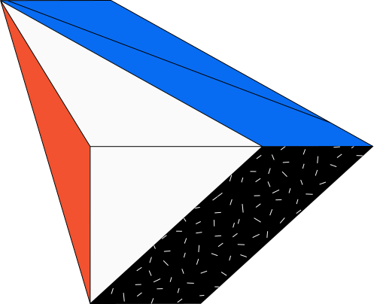
Introduction
A centralized platform that revolutionizes workplace productivity and communication
Seamlessly integrates various organizational functions into one user-friendly interface while fostering real-time collaboration between employees
Leverages artificial intelligence, our platform enhances employee efficiency, streamlines decision-making, and promotes a cohesive work environment

Slide 4
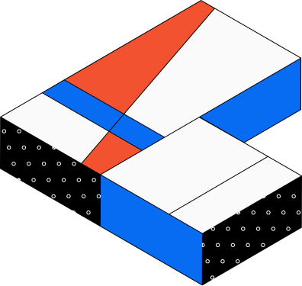
Schedule and Task Management: AI-driven task allocation and progress tracking
Intelligent Recommendations: Personalized suggestions for tasks, resources, and collaborators
Data Analytics: Advanced insights into team performance and project status
Knowledge Management: Centralized repository for company information and best practices
Key
Features

Slide 5
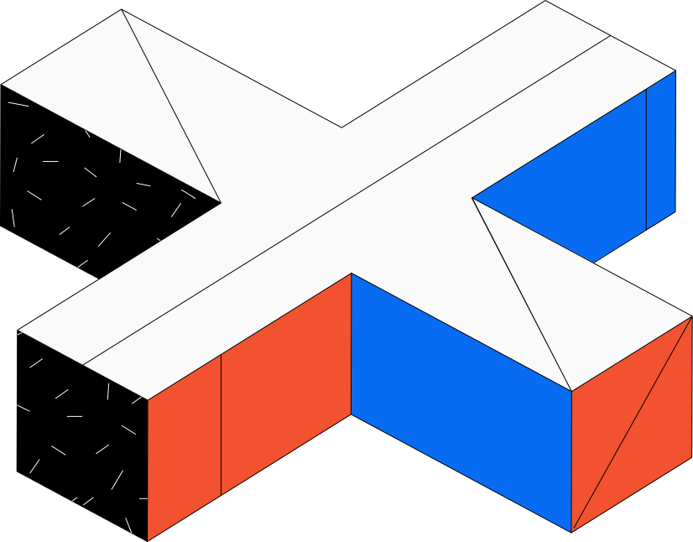

BCAT Challenges
Communication
Automatic Notifications
Progress Tracking
Meeting Summary
Scheduling Setup
Project and Event Collaboration
Certificate Management
Integration of all Apps

Slide 6

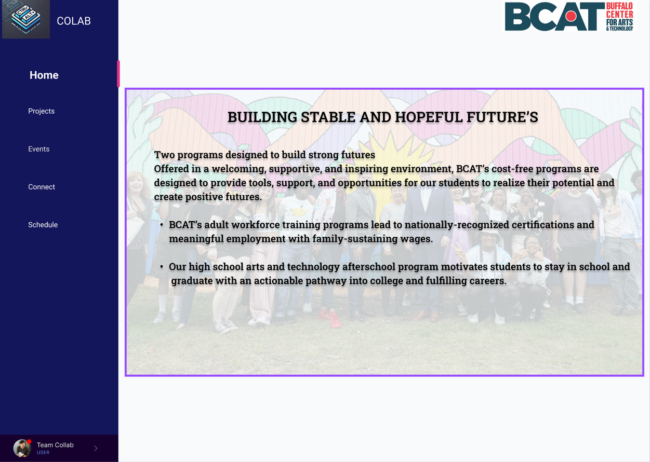







Project Collaboration
Colab Bot
Event Collaboration
Colab Bot
Communication and Networking
+ Colab App
Meeting Summary
+ Colab App
Automatic Notifications
+ Colab App
Certificate Management
Colab Bot
Progress Tracking
+ Colab App
Scheduling
Setup
+ Colab Bot

Slide 7


Scheduling
User Prompt
Preprocessing
Appointment Scheduled
User Schedule Retrieval
Availability Verification

Slide 8
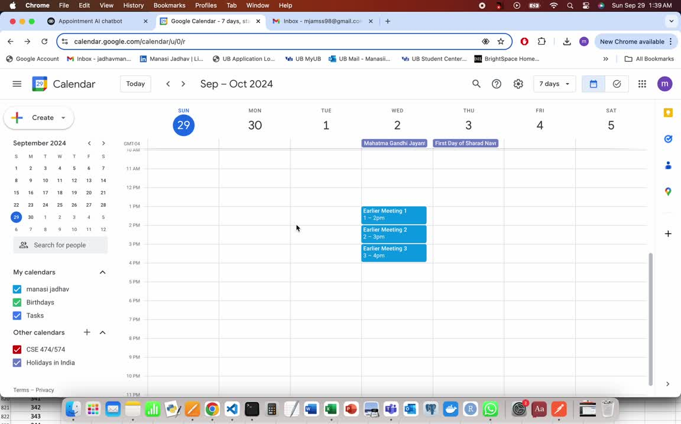

Slide 9

Project and Events Collaboration Recommendation System
Event Suggestions
Project Creation and Description
Collaboration Ideas
Recommendation Outputs
User Profile
Data Collection
Recommendation Engine
Project
Data Preprocessing
Event
Feedback
Collaboration
Feedback Loop

Slide 10
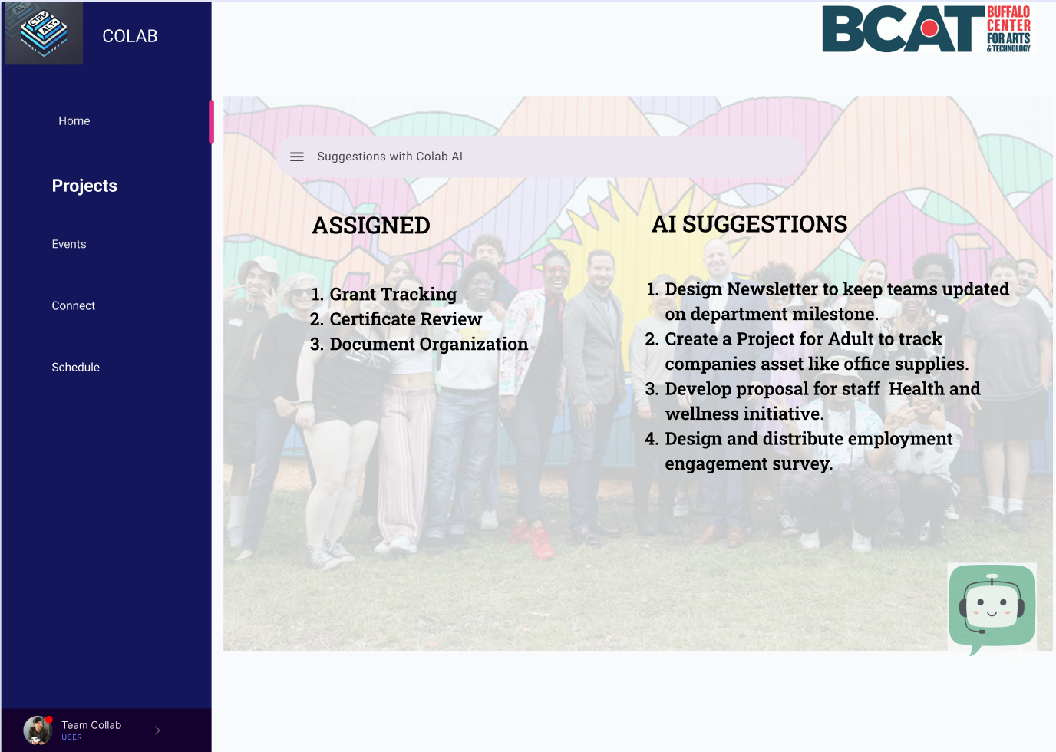

Slide 11
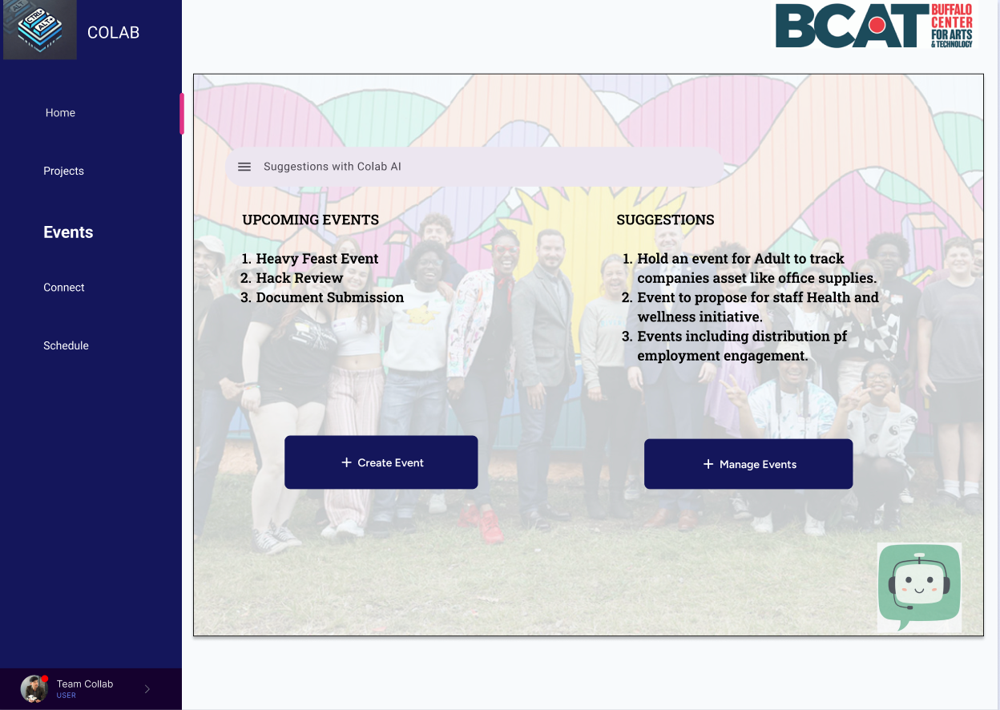

Slide 12

Interesting People Finder During Events!
User Profile Data Collection
People with similar experiences and ambitions
-Bio
-Profile pic
Recommendation Engine
Data Preprocessing
Extension - Location Access for exact position of person in the room

Slide 13
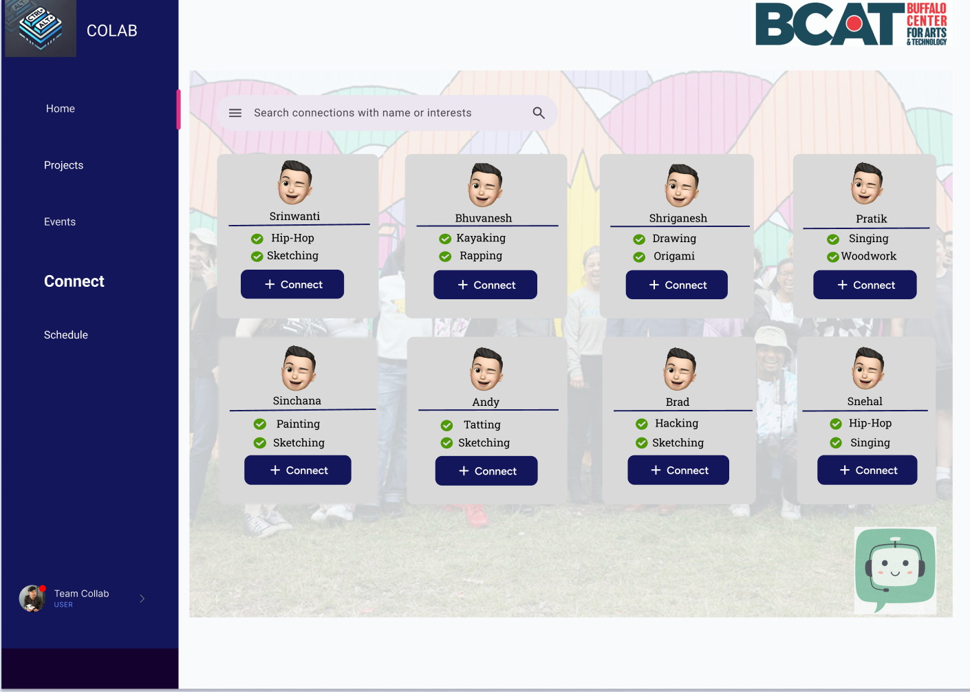

Slide 14
Project, Event and Connections Recommendation
Profile Creation
Connection Suggestion
Project Recommendation based on skills, hobbies, goals and user interation
New Event Creation Prompts to Program Coordinators based on skills, goals, and market trends
Event Recommendation based on Profile

Slide 15
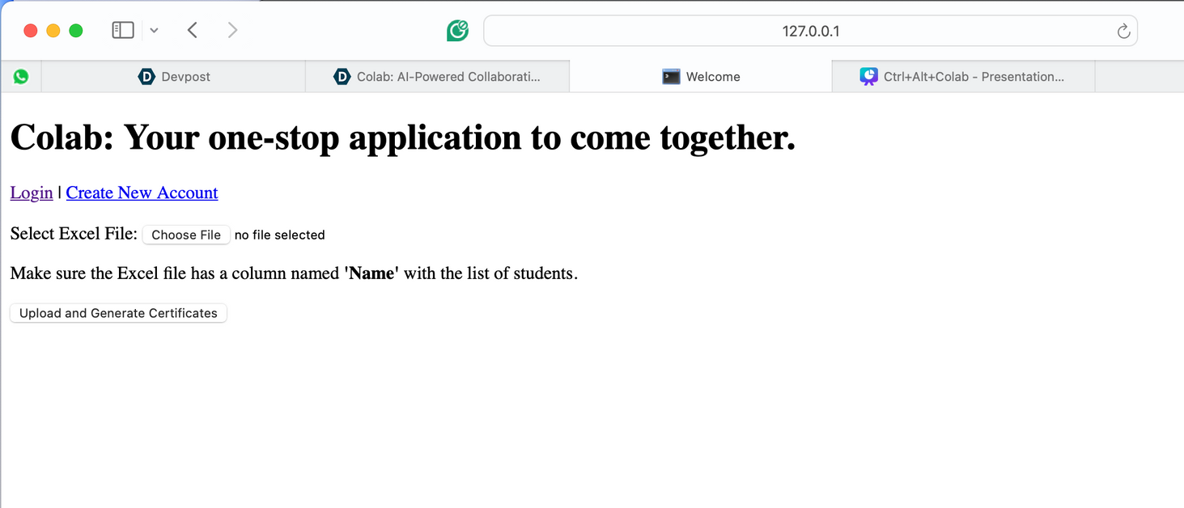
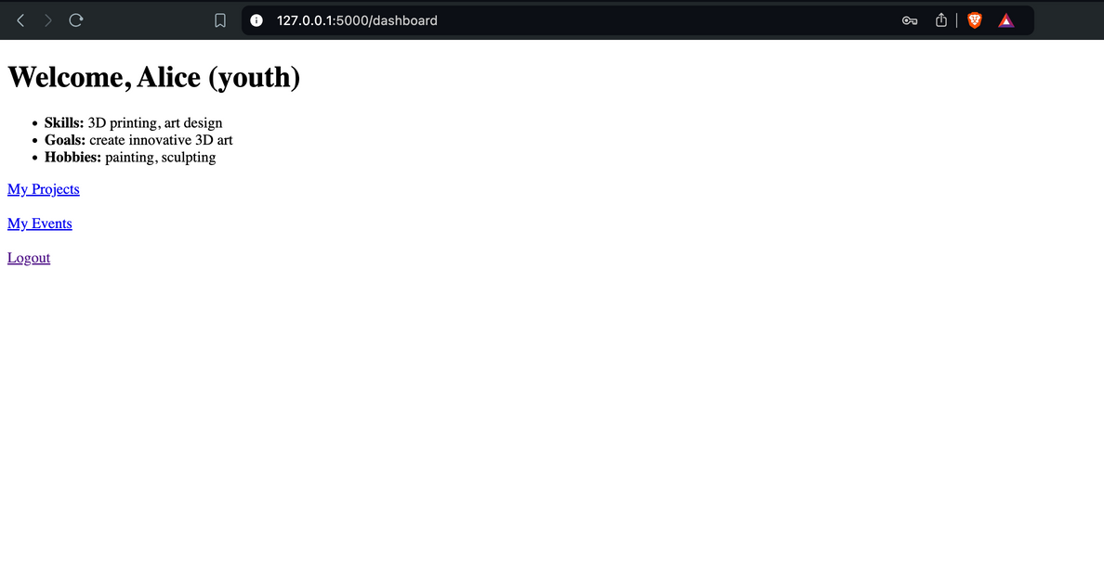
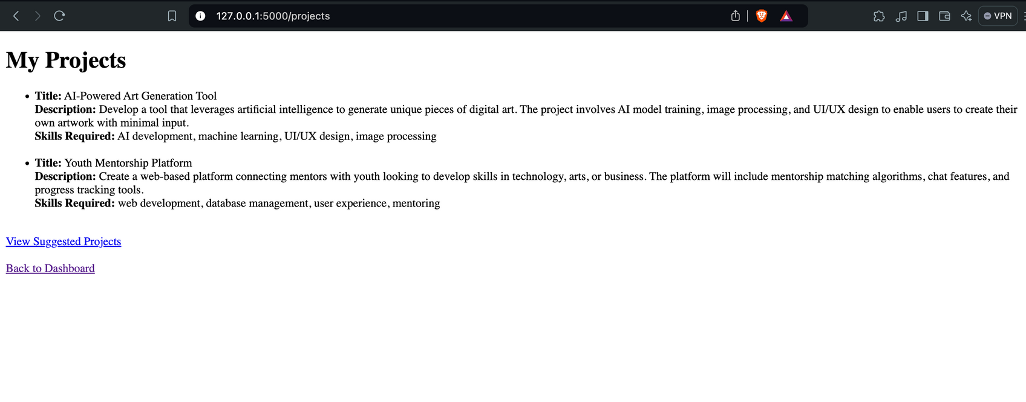
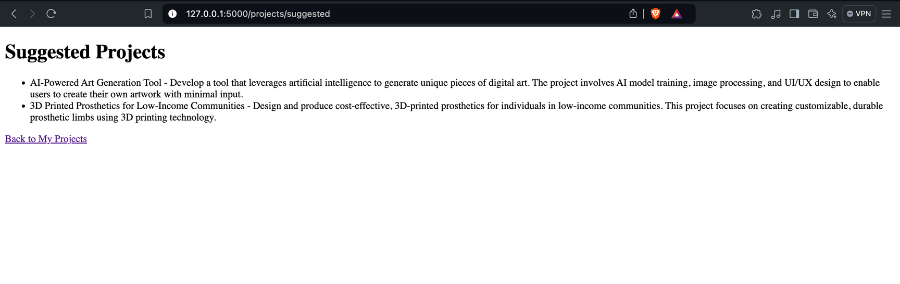

Slide 16
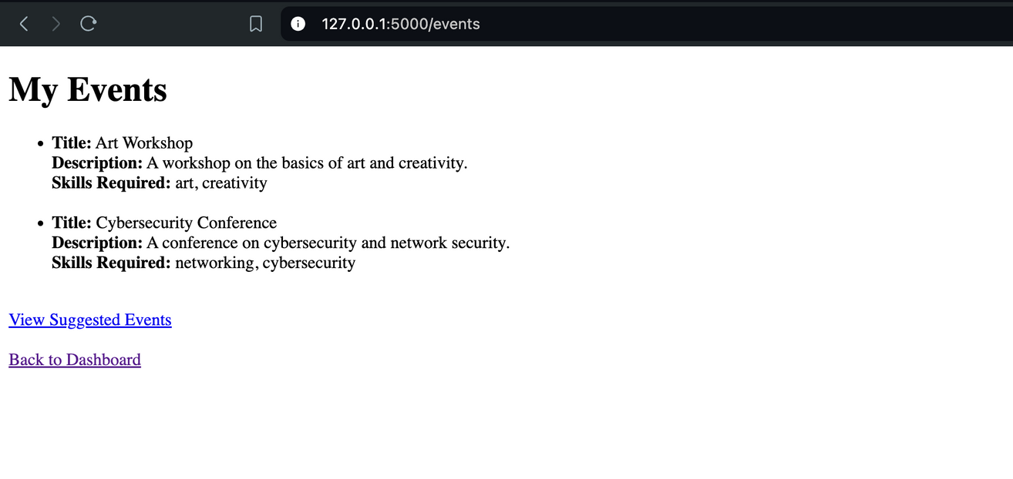
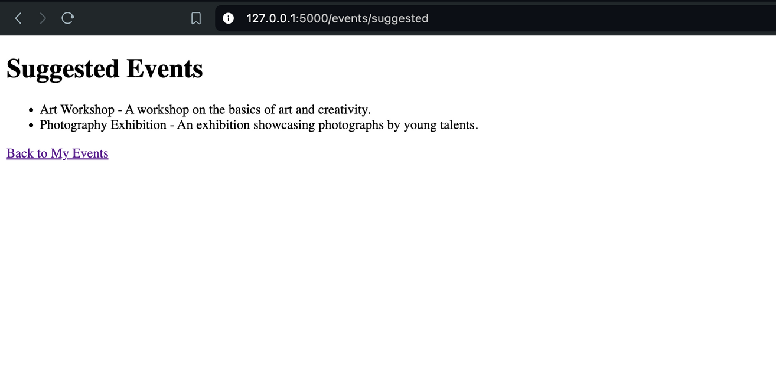

Slide 17


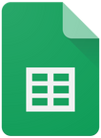


Automated Certificate Generation System
User Request
Fetch data and template
Data Filtering
Hey Colab, please generate a course certificate for all adults in the IT department.
Certificate generation

Slide 18
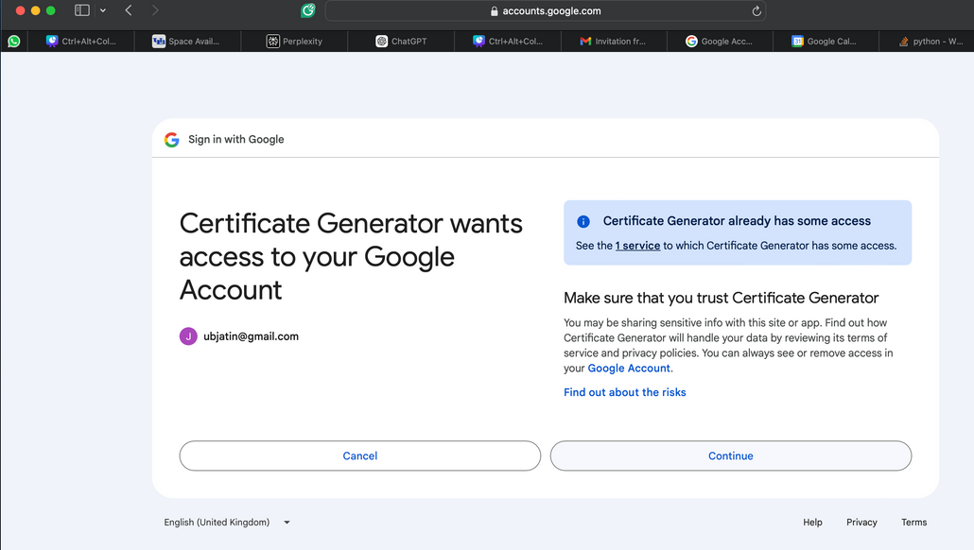
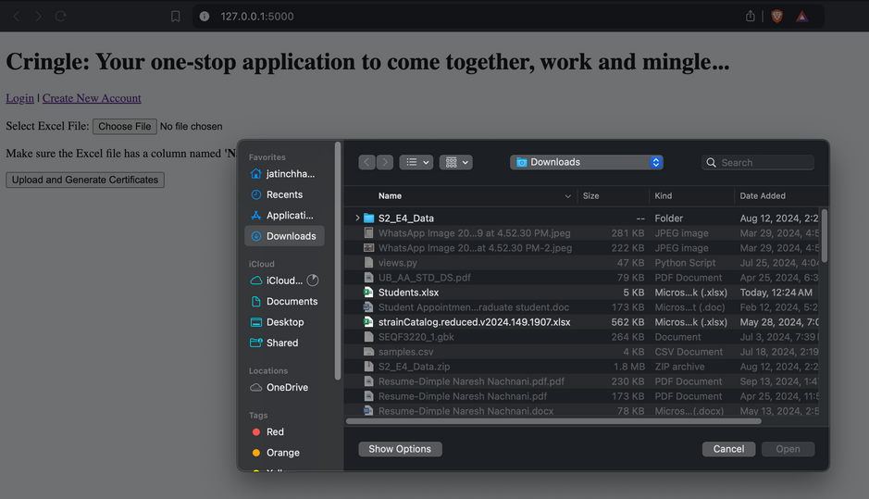
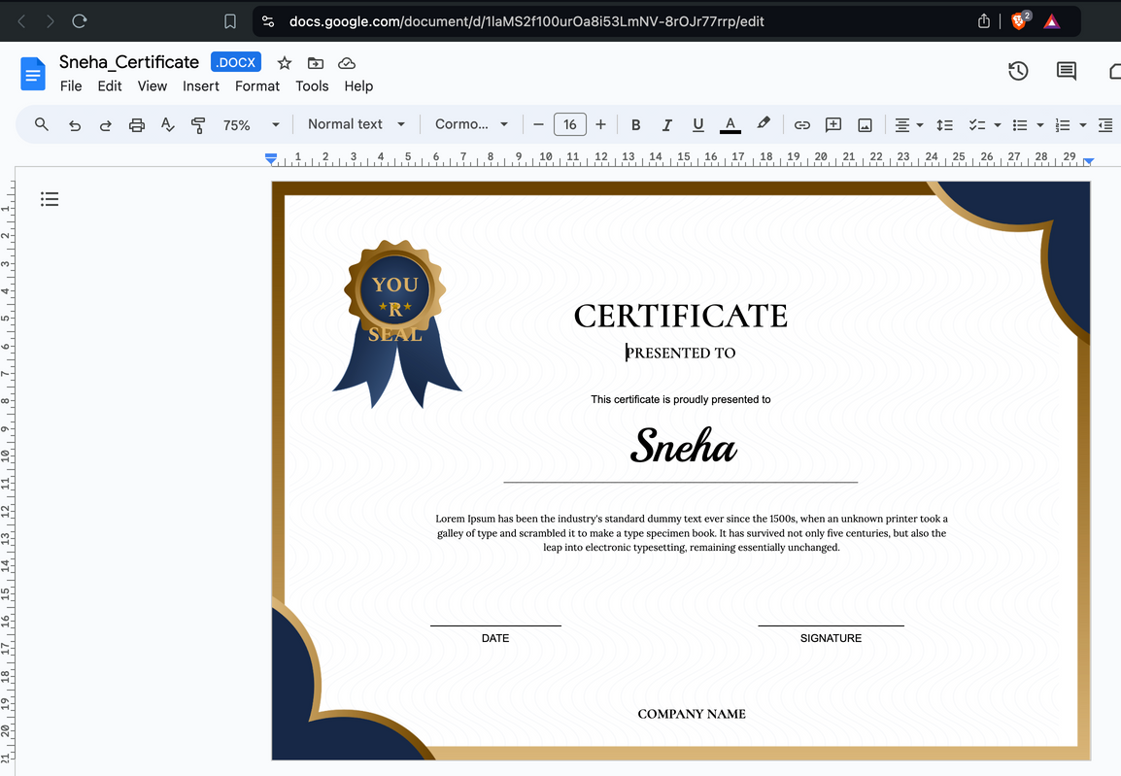
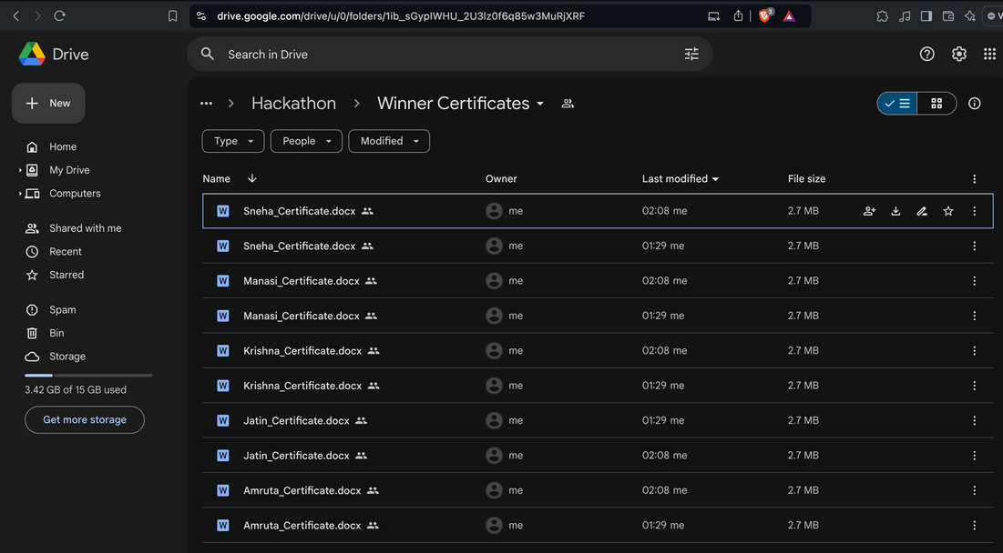

Slide 19
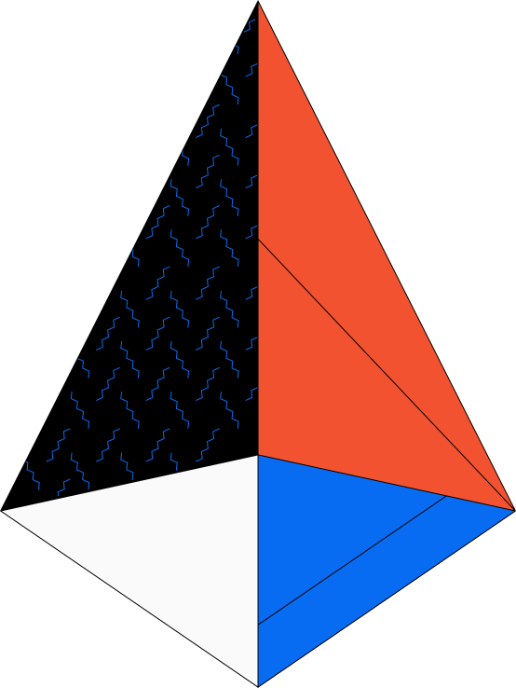

Increased Productivity
Benefits
Streamlines workflows and reduces time spent on administrative tasks
Enhanced Collaboration
Facilitates seamless teamwork across departments and locations
Improved Decision Making
Provides data-driven insights for strategic planning
Organizational Agility
Enables quick adaptation to changing business needs and market conditions

Slide 20
Implement a gamified point/reward system to boost collaboration and engagement.
Integrate with Salesforce for improved CRM.
Merge all functionalities into a single web platform.
Achieve end-to-end Google Workspace integration via APIs
Implement voice commands in the chatbot for task automation
Add multilingual support for community inclusivity.
Future
Work

Slide 21


Timeline
October
November
December
January
February
Planning &
Research
Platform Development
Platform Development
Testing
Documentation &
Maintenance

Slide 22

A
J
K
M
S

